Slide 1

Traffic in the Lehigh Valley
Group 5 Final Project Presentation
Joel Camacho
Mohamed Mazarul
Bradley John

Slide 2





Type of vehicle Collisions + conditions = impact to traffic
Rear End
T-Bone
Single Vehicle
Low/High Speed
External Factors
Impact to traffic
1
2
3
4
Least (i.e., a short delay)
Significant (i.e., long delay)

Slide 3
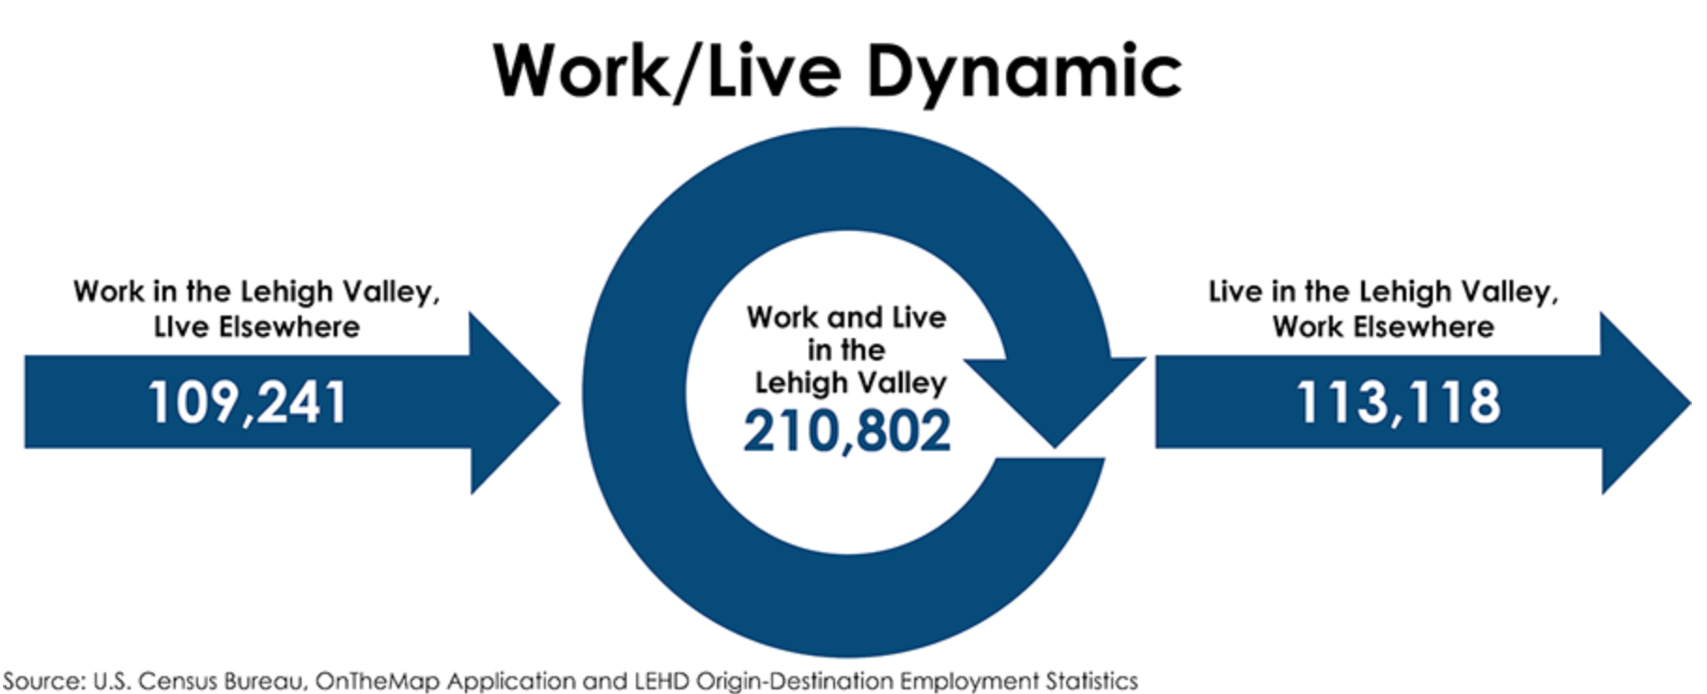
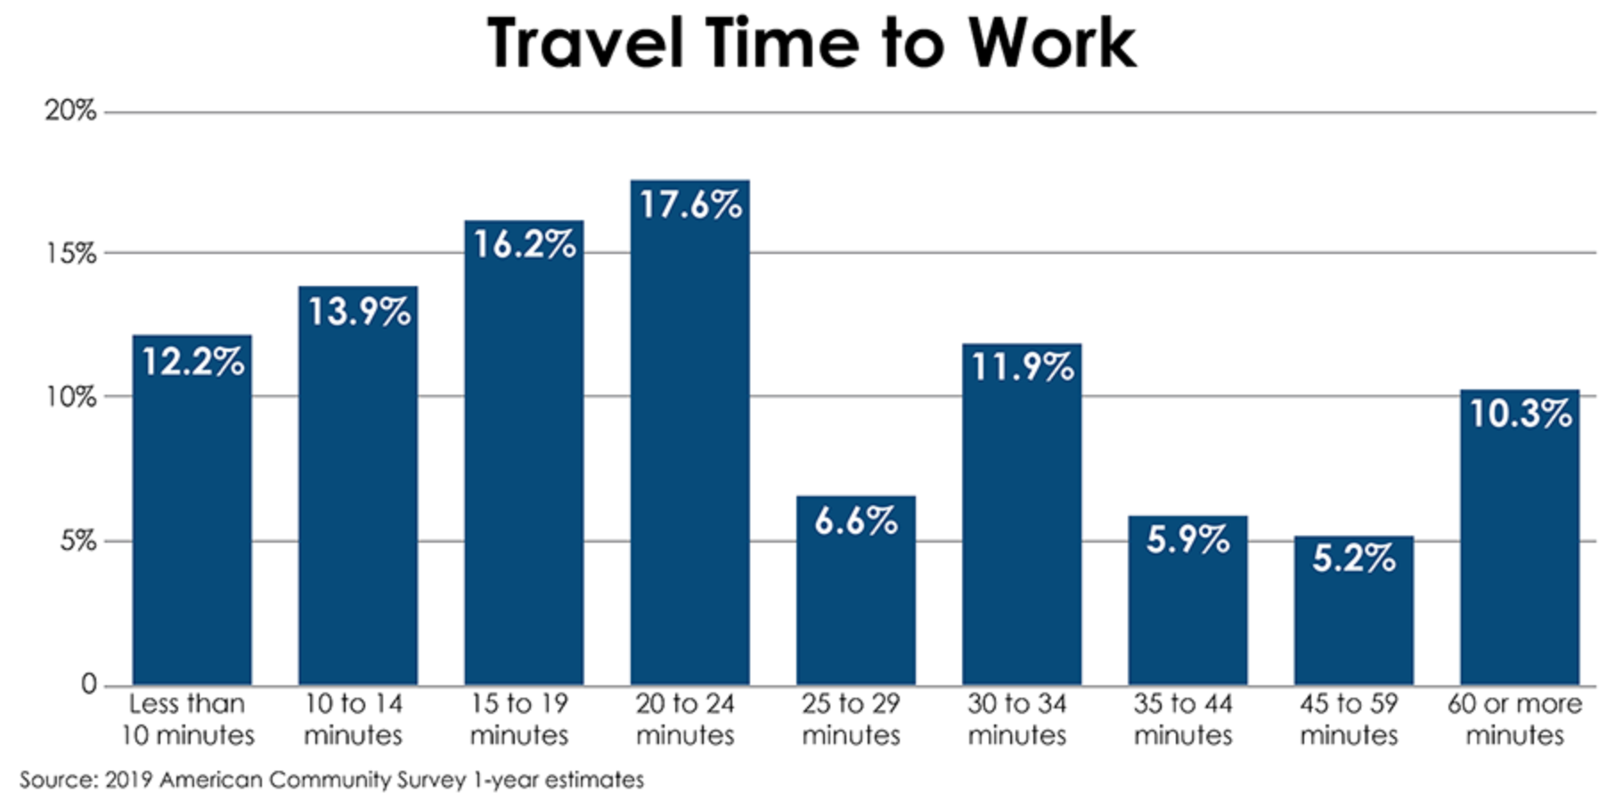
Contributions and improvements
Population and Business growth
2020 U.S. Census reported that the Lehigh Valley has grown over 6% the past ten years
Increase number of warehouses/distribution centers
Increase number of pass-thru traffic (commuters)
Longer commute times (82% drives to work)
Infrastructure Projects
Focus on high traffic roads (e.g., RT 22 and Interstate 78)
Reflective markers along Route 22 and 378
Monitor road conditions with camera and Realtime updates
Higher percentage traveling eastward due to high-volume roads
Longer on the road, higher chances of accidents

Slide 4
Data source and analysis
US Accidents from 2016 – 2021
FARS database from the National Highway Transportation and Safety Administration
2+MM rows and 47 attributes collect via multiple APIs that provide streaming traffic incident (or event) data
Filtered to Carbon, Northampton and Lehigh counties within PA (3200+ records)
Data was further analysis for data quality issues and remediated (e.g., nulls or blanks)
Data was scaled to focus on areas that impact us as a local community
Final dataset was loaded and modeled in SAS EM
Data Partition (training, validation and testing)
Several models (Regression, Decision tree and Neural Network) were applied to identify key indicators
Text Mining used on qualitative data to identify themes

Slide 5
Motivation
What does the data tell us on the key questions we set out to answer? Which are;
Does higher severity accidents, which typically involve greater costs, possibly loss of life and cause longer traffic delays due to emergency responders, investigation, clean-up, and road repairs?
Areas with the highest frequency of accidents, which involves the highest total costs, recurring traffic delays, indicate the need for preventive measures or road repairs?
We set to model the factors contributing to accident severity based (e.g., weather and traffic patterns, frequency of accidents)
In addition, we having data regarding time of accident, locations, weather conditions, and how traffic was affected afterward

Slide 6
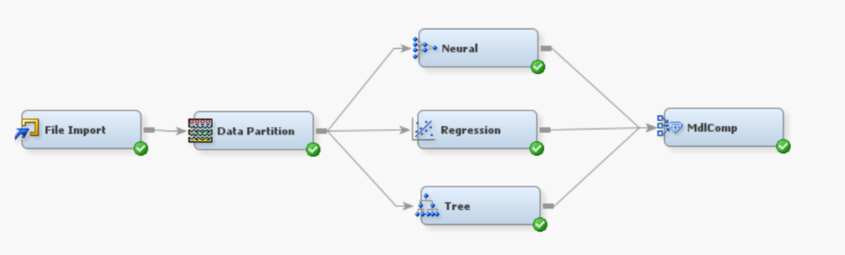
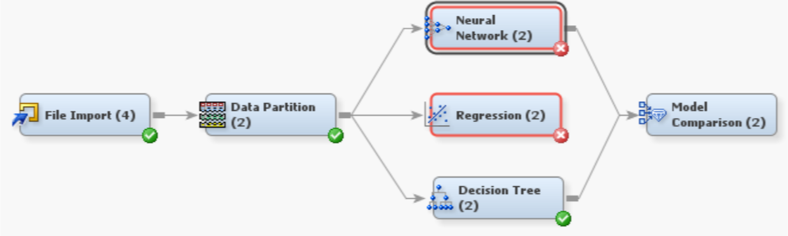
Model Outcome
Logistic regression was selected for the best model to determine the severity level
Misclassification results was the same across decision tree and logistics regression
The features that met our p-value criteria (.05) included; whether it was a street intersection, whether a railway was a factor in the crash, the presence of a gas station, and the presence of a traffic signal. A few unexpected surprises (e.g., presence of a stop sign did not have the weight that we would have expected)
Misclassification rate was still higher than expected, inputs were expanded to include weather conditions
The Regression and NN models errored due to the 512 cap in EM

Slide 7
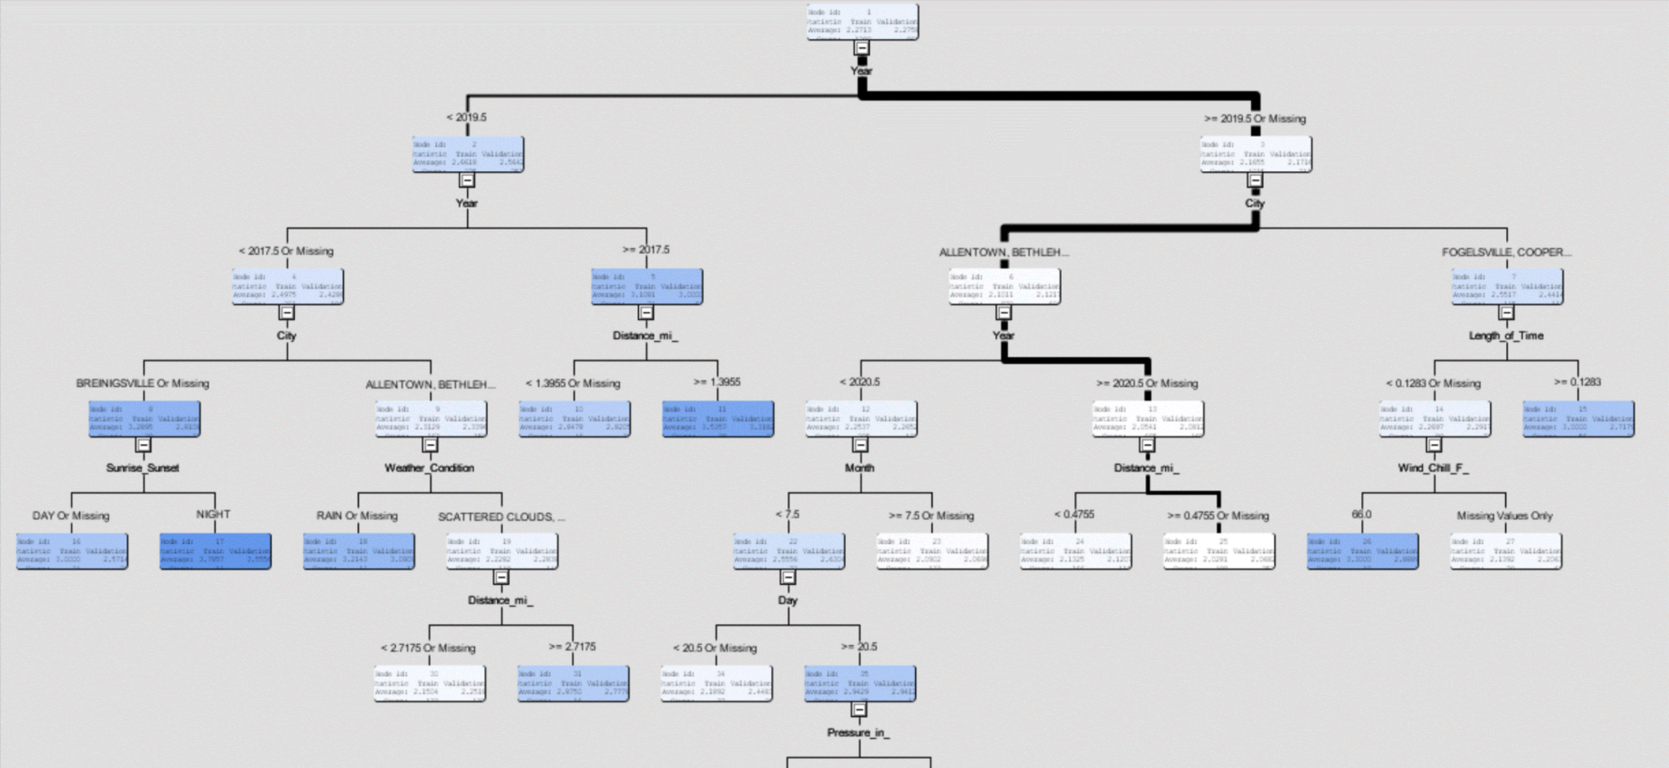
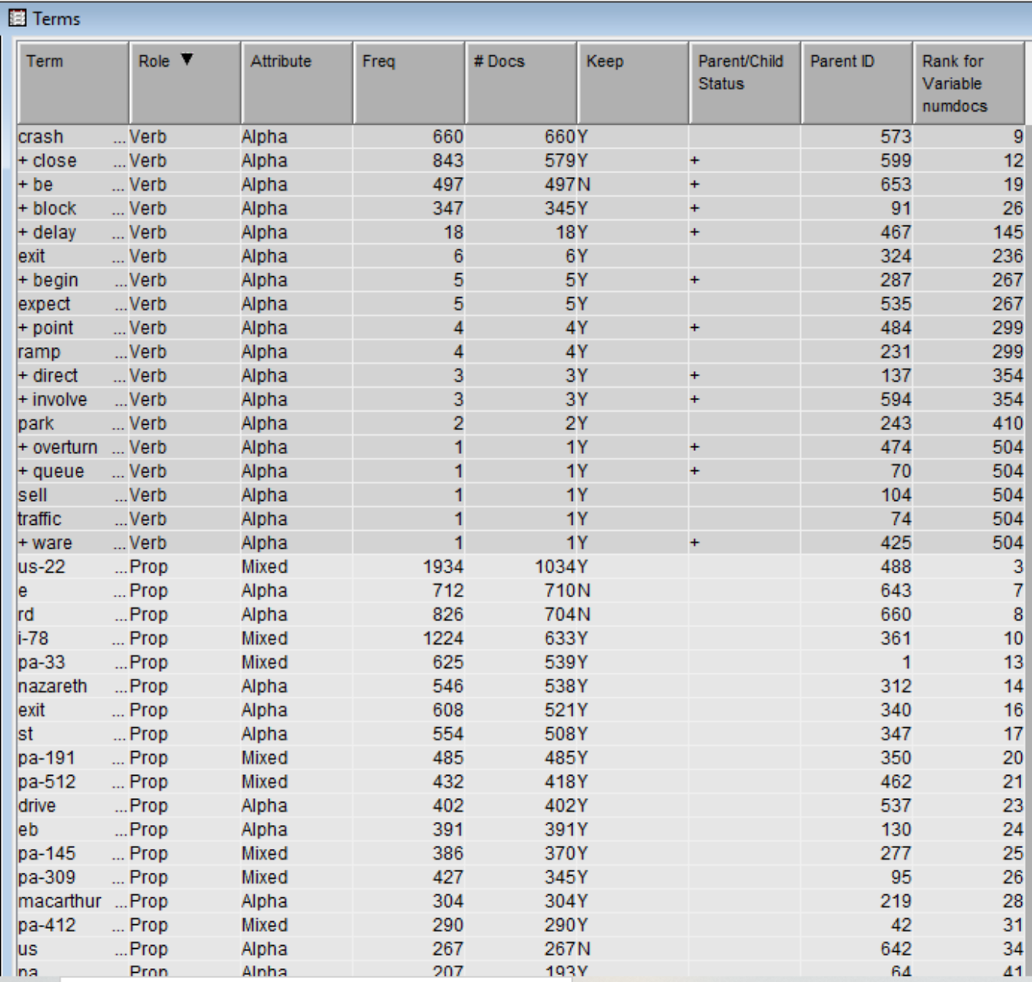
Model Outcome (continued)
Fit statistics for the tree deteriorated compared to the logistics regression
Was the regression model a better for EM due to the 512 cap or the new attributes less impactful?
The regression model was re-ran using just the new attributes
Eliminated the time and distance measures due to uniqueness to each record
Results, the road characteristics (human control) had more of an impact that the weather or temporal attributes in the aggregate
Text Mining was conducted to identify specific locations and other characteristics
Construction (while not active) and commuter hours were additional drivers
Additional validation was conducted in MS Excel on the description variable

Slide 8
Recommendations
New road projects for safety should focus on those that have characteristics noted combined with a high rate of frequency identified in the text mining
Other preventative measures funded by taxpayers that may decrease accidents in these high-volume areas are electronic speed limit posting that the department of transportation or analytical algorithm can update on a real time basis
Preventative measure such as electronic speed indicators that enforce the speed limits by capturing photos of the vehicle
Larger project recommendations include re-designing the on and off ramps
Having individuals involved in the decision-making process that have personal knowledge of the geographic areas in this scenario is critical

